Slide 1

Course Registration System

Slide 2
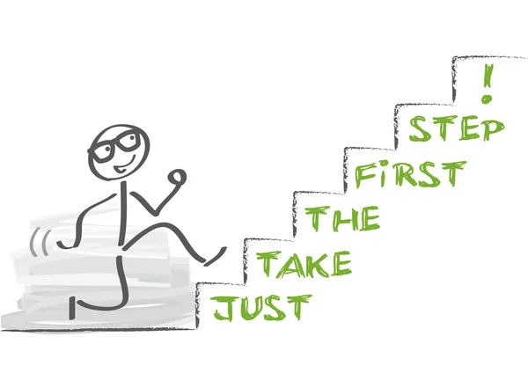
The Ask –
Where we started?
Notes:
Yes Good morning all, First question to answer: Where we started ? So we started with a problem statement of Central Registration System, where we had many functionality like student can register, add/drop course, professors can view courses and enrolled students while admin can manage users, add/drop courses to catalog, we progressed by making UML artifacts i.e Use case Diagrams, Activity Diagram, Class and Sequence Diagram and then transforming these beautiful artifacts to code.

Slide 3
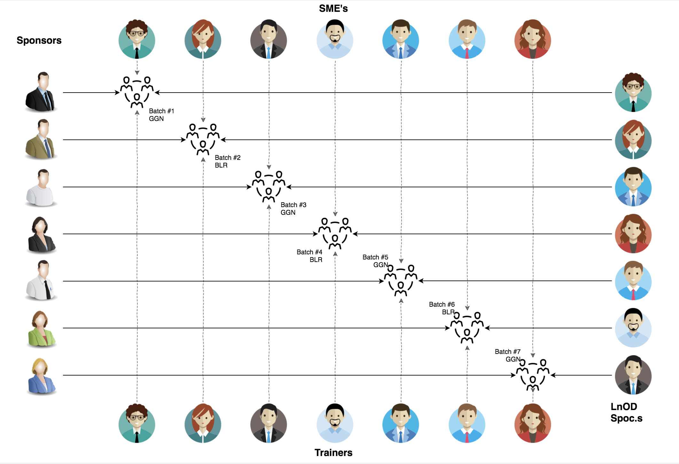
Stakeholders
Sponsors
1. Flipkart
SME’s
Amit Balyan
3. Trainers
Deepika Gajraj
Pooja
Notes:
But before discussing about project we would like to thank Flipkart for this wonderful training program, Our Mentor Amit and our trainer Deepika and Pooja.

Slide 4

Agenda
01
Our Journey
02
Our Team
03
Project Goals
04
Engineering Practices
05
Tech Stack
06
Development
07
Challenges & Learnings
08
Demo
09
Questions
Notes:
This is our Today’s agenda, a quick walkthrough:
First of all we’ll discuss our journey of building this Central Registration System, then a small intro of our fabulous team, after that we’ll talk about Project Goals, Engineering Practices, Tech stack and development, Challenges we faced and what we learned through that, and at last we’ll end our presentation by a Demo and QnA. So I would welcome Akash to join and tell us about our journey.

Slide 5

Our Journey
Notes:
Hello Good morning all. Let’s start with our journey of how we developed the Central Registration System.

Slide 6
Demo
Mindset
Process
5
Project Demo
Tools
4
Adapting to a developer
Mindset
Comprehend
3
Design Thinking
2
Decide the Technologies JAVA/REST
1
Understanding Project Goals
Notes:
In this representation we have shown various stages during our journey.First start with Understanding Project goals, For any successful application development it is important to thoroughly understand the problem statement, its feasibility and various in’s and out’s. Then we decided on technologies needed to incorporate the project requirements followed by its design and implementation part. It takes more time and resources required to correct same error during later stages of development hence a proper development cycle should be used. Now I would welcome Hitender for

Slide 7
Flow of Project
Dropwizard
3. Maven Project development
Apache Jersey
JAVA
2. RESTful Web services using Jersey
1. POS Application
Notes:
The project consisted of three major milestones, firstly a POS (Point of Sales Application) which was based on Core Java Standard Edition(JSE). The POS application incorporated strong Object Oriented Programming and OOAD principles. The second application was based on Java Enterprise Edition(JEE) where we developed a restful web API using Apache Jersey follwed by a DropWizard Rest API using Maven JAVA project on top of Jersey. We will have a more deeper dive into project technologies later during the presentation.

Slide 8

Our Team
Notes:
Time – 2 mins

Slide 9
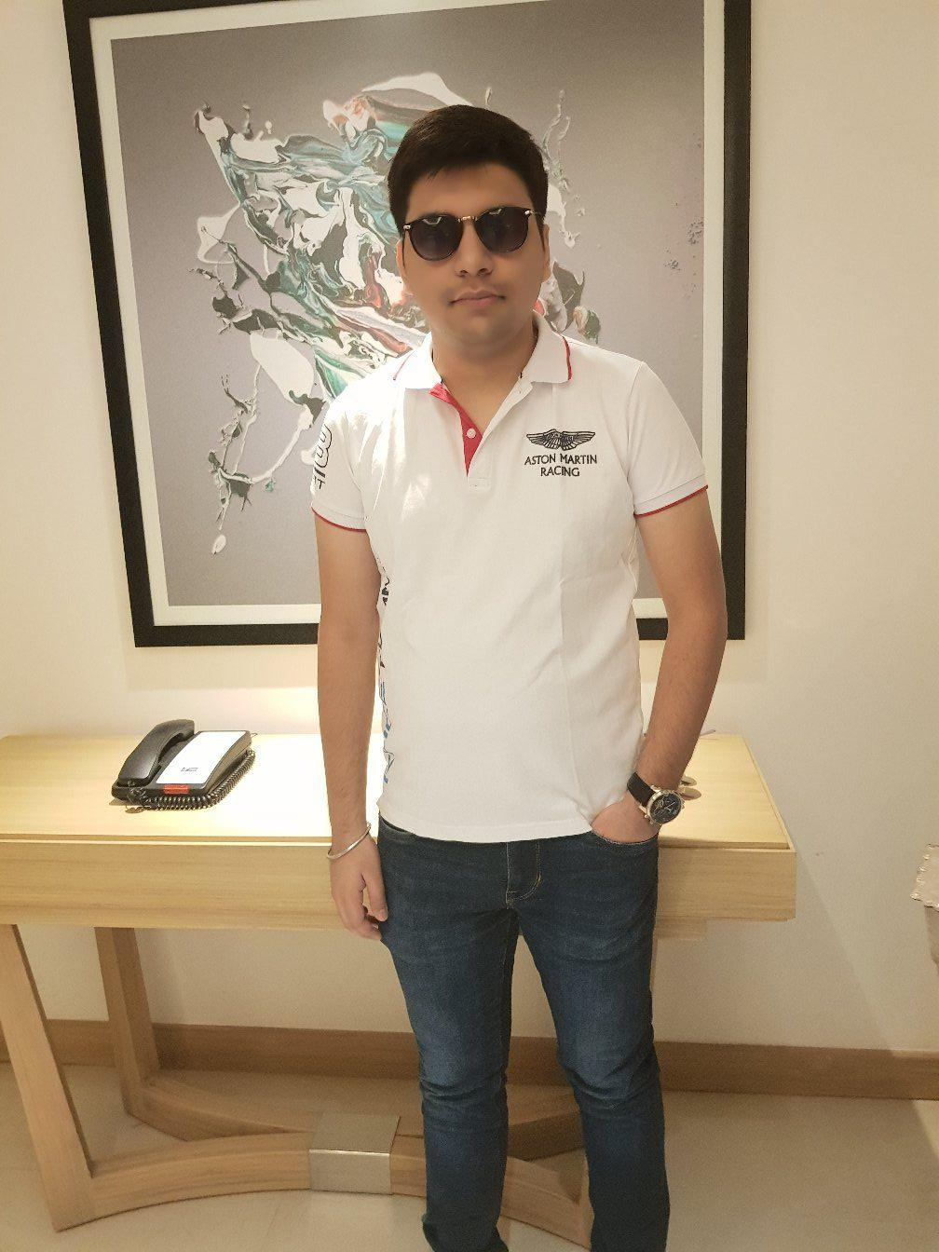
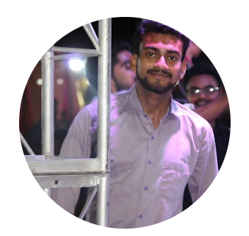
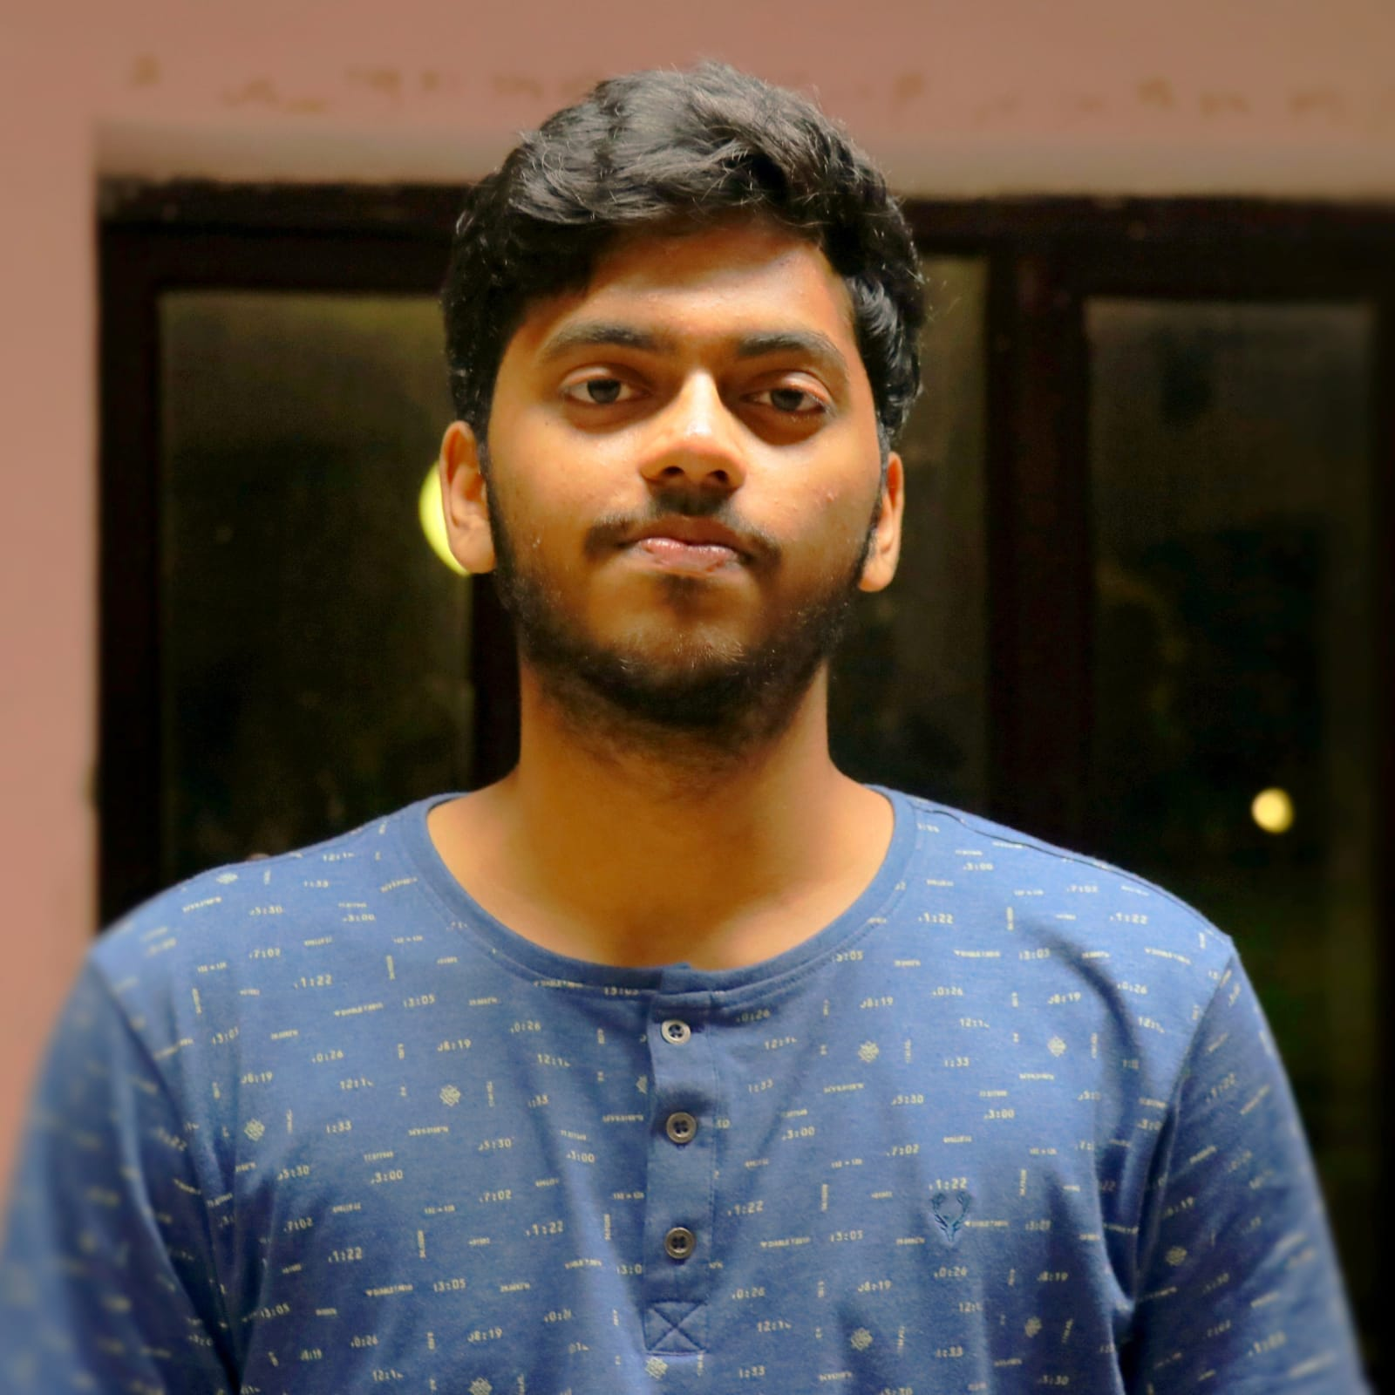
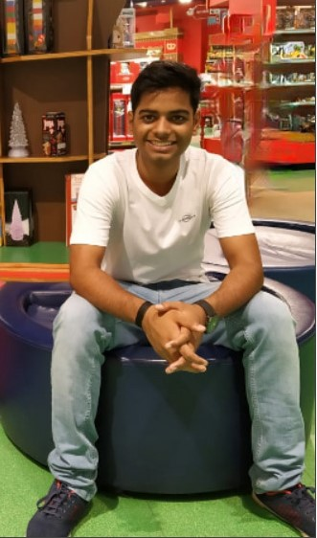
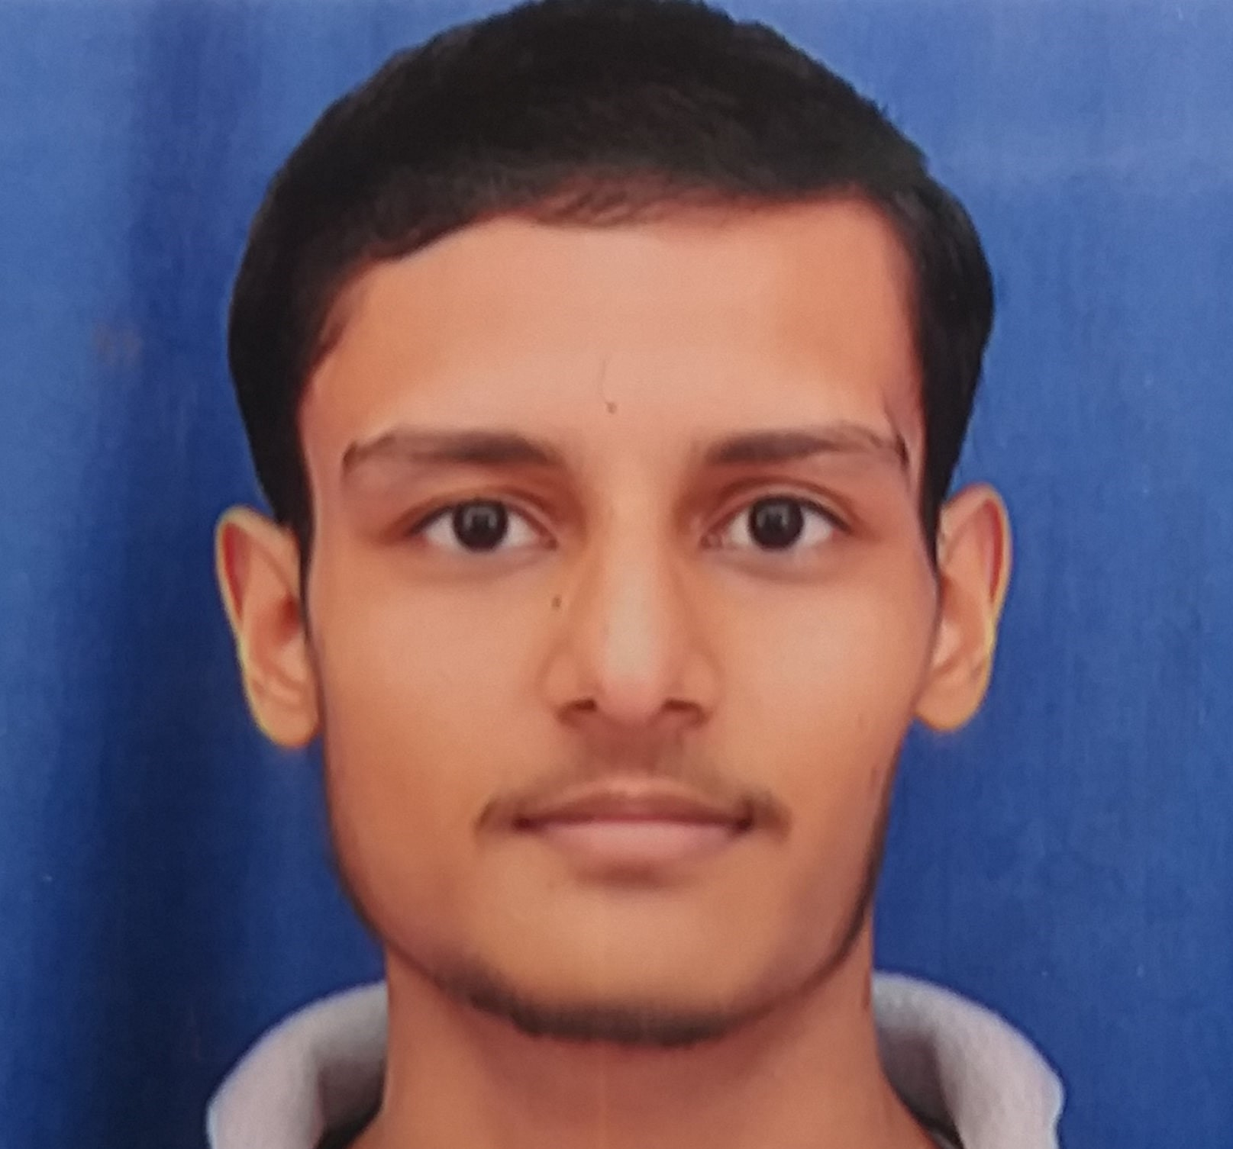
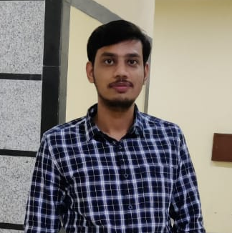
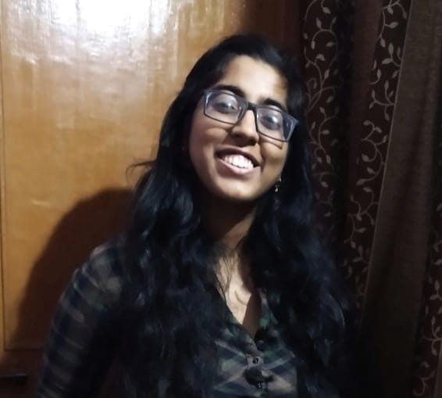
Aditya
Aman
Ashruth
Nitish
Hitender
Anushka
Akash

Slide 10
Our next starts
NOW
Notes:
Time – 1 min
Swati

Slide 11
1.5 WEEKS OF TRAINING + PROJECT DEMO
13 DAYS
101 HOURS
6060 MINUTES
363600 SECONDS
LIMITLESS KNOWLEDGE

Slide 12
ACTION PLAN
 | Modules | Description
Week 1 (Jan’17 - Jan’24) | UNIX GIT UML Diagrams | Understanding Unix and Git commands Requirement understanding and diagram design
Week 2 (Jan’24 - Feb’2) | Java 8 Exception Handling SQL Jersey DropWizard | Developing a POS Application using Java and MySQL. Understanding Java 8 features and collections REST API Development using Jersey and DropWizard framework

Slide 13

Project Goals
Notes:
Time – 3 mins

Slide 14




Our Vision
To create a Course Registration System using JAVA/REST tools and technologies, where a professor as well as a student can view courses and enroll in some of the courses.
1
2
Quality
Security
3
4
Interactivity
Speed
Notes:
User satisfaction and brand value

Slide 15

Engineering Practices
Notes:
Time – 5 mins

Slide 16
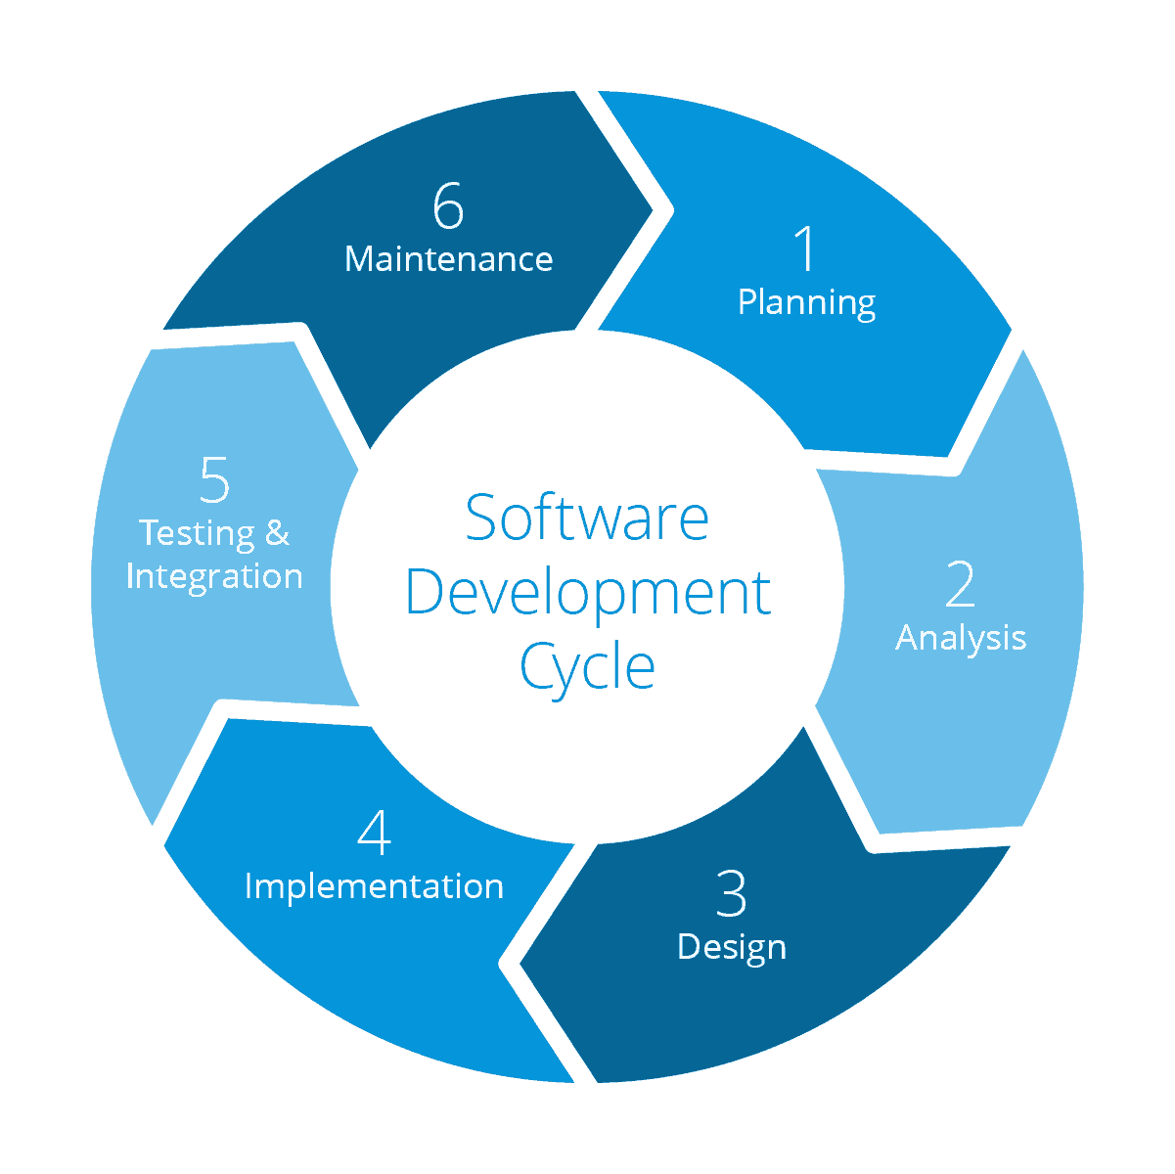
Requirement gathering
System Testing
Technology stack selection
Code implementation and development
UML artifacts design

Slide 17
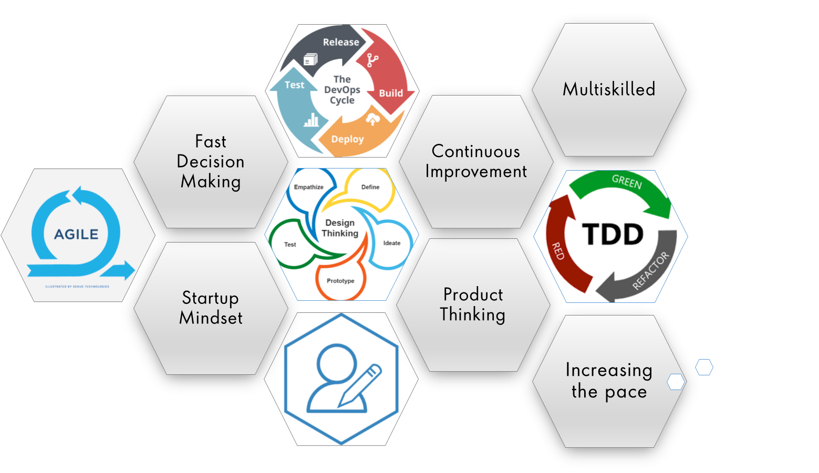
Notes:
Product Thinking (Design Thinking, Requirement Analysis, )
Multi Skilled (Frontend, Backend, DevOps)
Fast Decision Making (Agile)
Increasing the Pace (Automation CI/CD)
Startup Mindset (Agile)
Continuous Improvement (Retros)

Slide 18
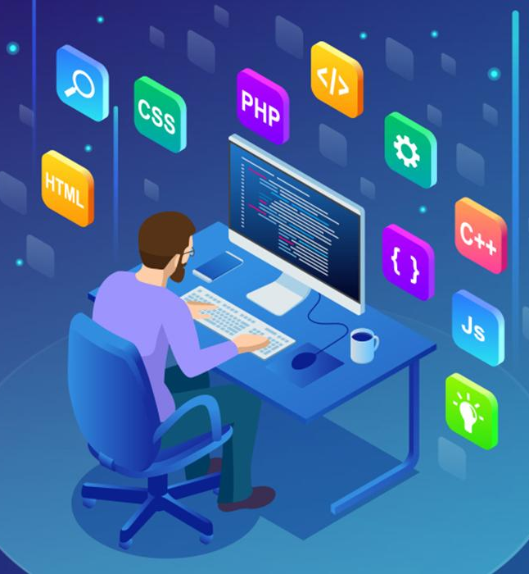
Tech Stack
Notes:
Time – 2 mins

Slide 19










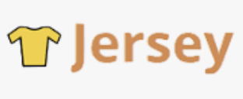
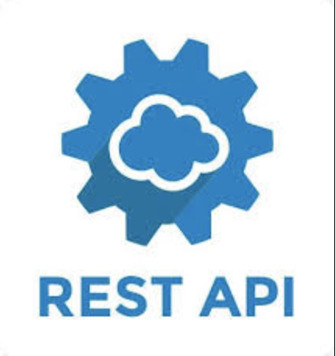


Designing
Backend
Testing
Data
SCM
UML
Core Language
Tools
SQL Database
Code Collaboration
Framework
Application Server
Notes:
Time – 1 min
Java
Maven
DropWizard
MySQL
Jersey
GitHub
Postman / ARC (Check it)
StarUML / Dia / Lucid Charts
List
Design
Backend
Testing
Tools

Slide 20

Development
Notes:
Time – 1 min

Slide 21

POS Application
HTTP Request
Java Main Client
Business Code
Database Code
HTTP Response

Slide 22

Demo
Notes:
Time –
POS- Student -5 min
REST - Professor - 3 min
DropWizard- 3 min

Slide 23

Challenges & Learnings
Notes:
Time – 2 mins
Challenges-
Installing the Tomcat server and running application on it.
Learnings-
Got to learn new technologies.
Learnt working together in teams.(collaboration)
Learnt how to write code which is accepted by the industry.
Learnt how to make UML diagrams for the given problem.

Slide 24
Challenges
Learnings
Installing the Tomcat server and running application on it.
Setting up the dropwizard project.
Making connection and debugging the code.
Collaboration issues such as merge conflicts in Git
Got to learn new technologies.
Learnt working together in teams.(collaboration)
Learnt how to write code which is accepted by the industry.
Learnt how to make UML diagrams for the given problem.

Slide 25

Questions
Notes:
Time - ?

Slide 26
Thank you
Notes:
Time – After this show the testimonial video. 1 min

